Slide 1
RTOS Introduction
Embedded Firmware Class

Slide 2

Interesting Facts
The Mars Rover suffered from an RTOS priority inversion.
The bug was a developer bug, as the RTOS had priority inversion capability but developer turned it off for a task
The developers had noticed issue during development but figured it was a hardware glitch

Slide 3
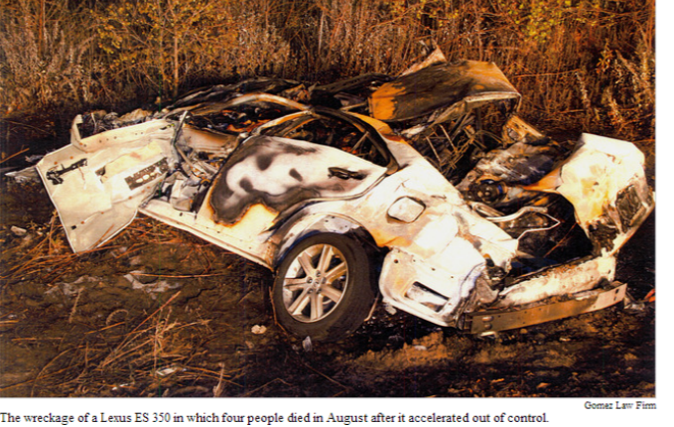
Toyota Unintended Acceleration
Car crash to left was driven by 45 year old CHP officer.
Passenger called 911 during problem
All 4 occupants killed.
Code described as “spaghetti code” what was considered “untestable”
Over 9,273 Global variables
Global variables are evil
Task concurrency and volatile variable errors

Slide 4

Agenda
What is an RTOS and how different from operating system
Why use an RTOS
Cost of an RTOS
What is normally including in an RTOS
Key concepts of RTOS
Scheduler
Mutex/Semaphores
Memory Management
Tasks
Tick verses Tick-less RTOS
Bugs RTOS verse Bare Metal

Slide 5
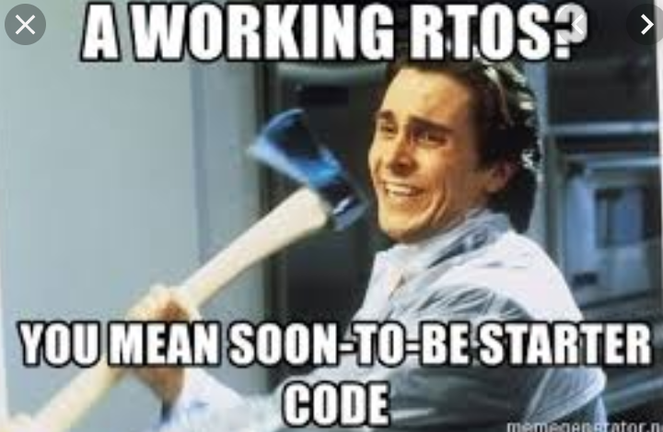
What is RTOS
Real Time Operating System – RTOS
Real Time means that from time a task is flagged to run until it runs is bounded by maximum time.
Generally Includes
Task scheduling
Memory Management
Mutual Exclusion (mutex) and/or semaphore
Task to Task communications
Hardware Abstraction

Slide 6
Why Use an RTOS
First off anything you can do with an RTOS can be done without one!
RTOS provides an abstraction layer which allows tasks to be developed independently.
Good RTOS abstracts processor and hardware drivers
Code can be ported to another processor often as simple as just recompile.
Faster code development
Multiple developers working on independent tasks
Fewer bugs

Slide 7

Cost of RTOS
RTOS is not free…
Takes time away from doing to manage
Takes resources (memory, code space)
Takes more power (battery life)
Requires a shift in mindset

Slide 8
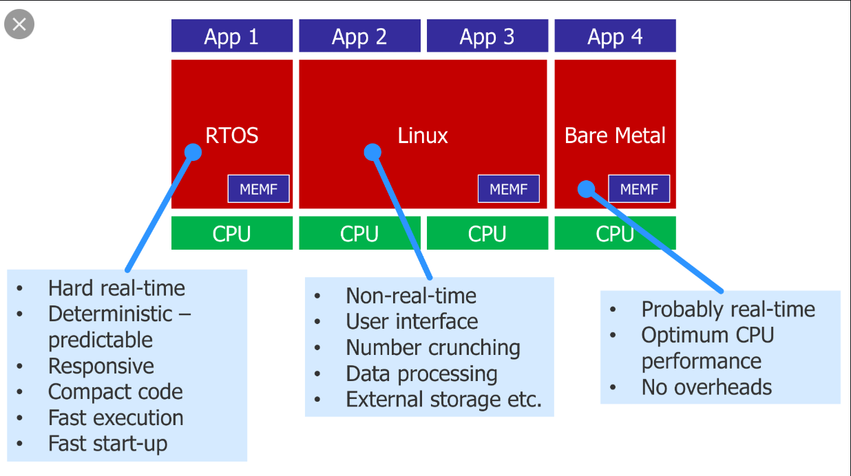
RTOS, Linux, Bare Metal
Linux is not Real Time
Bare Metal is optimal use of hardware.
May not be optimal use of time and money
RTOS is a blend
Costs in hardware (CPU, RAM, etc.)
Reduces development costs

Slide 9

RTOS Includes
Scheduler
Determines which task (code) to run next
Mutual Exclusion (Mutex) and semaphores
Allows atomic code operation
Prevents two tasks from using same resource at same time
Memory Management
Often replaces malloc with error checking and memory management
Pool based memory management for example
Concept of Tasks (processes, or threads) often with own stacks
Can be tick or tick-less

Slide 10

RTOS Application
On an RTOS you run an application
The application under the covers run multiple tasks to accomplish specific actions
Examples:
Task to run web server
Task to run serial data logger
Task to sample ADCs
Task to do signal processing
Etc.

Slide 11
Tasks
In a desktop OS (Linux, Windows, etc) a program runs as a process, a process can have multiple threads. All of which can run concurrently.
In a RTOS it is common to call a process, a task.
Generally a process can have threads
A task contains no threads and does one thing and only one thing well
Tasks are basically small self contains programs
They have their own stacks (usually)
They run as though they are only program running
They do one thing and only one thing

Slide 12
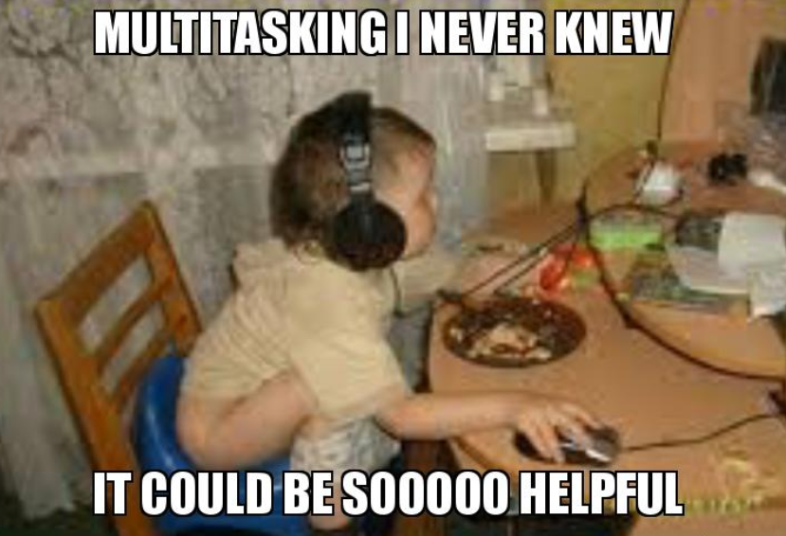
Scheduler
Scheduling when do things to get them done on time is often just as important as doing them.
Scheduler picks which task to run and when to switch tasks
There are infinite scheduler algorithms
Cooperative
Round robin
Priority based
Etc
Can be preemptive or not

Slide 13

Cooperative
Each task runs for what it thinks is fair amount of time then yields to next task.
The “We are all friends here” scheduler
A task could never yield and consume all of the processor’s time.

Slide 14
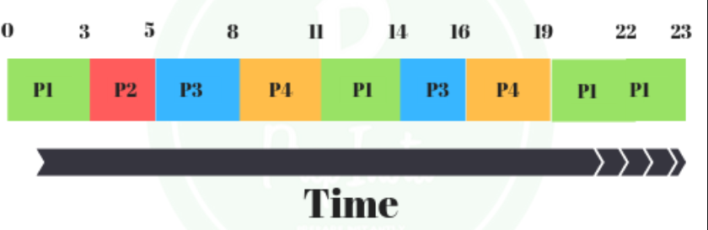
Round Robin
Round Robin scheduler is where each task gets processor time in order for a determined amount of time.
The time can be predetermined and weighted for each task
No task can consume the processor
A task can be removed from processor at any time

Slide 15

Priority Base
Tasks run based on who has highest priority
The boss gets coffee maker first approach
Each task is assigned a priority and one with the highest priority gets processor time first.
A low priority task may never get processor time
If everything is top priority then we are back to cooperative.

Slide 16

Preemptive Scheduler
The OS can kick a task off processor at any time.
Usually because higher priority task needs to run.
The I am bigger and can force you to do it
This requires task priorities to know who gets processor next

Slide 17

Other Scheduler Algorithms
Preemptive with minimal time
Preemptive with guarantee run every xx seconds
Scheduling based on resource availability
See BFS
Lots of others

Slide 18
Mutual Exclusion and Critical Sections
What if task is in the middle of critical code when it is kicked off processor?
Need a way to prevent RTOS from kicking off during critical sections of code.
Critical sections of code should be short as even high priority tasks can not interrupt them.
What if a task is using a peripheral or resource?
We need a way to lock that resource to prevent others from using until our task is done
Mutual exclusion and semaphore to the rescue
Next class we will discuss priority inversions and deadlocks

Slide 19

Memory Management
Not really required for an RTOS
RTOS often need to dynamically allocate memory internally so usually included.
Often uses block of memory for allocation, or pools.
Basic idea is to prevent memory fragmentation from use of dynamic memory allocation.

Slide 20
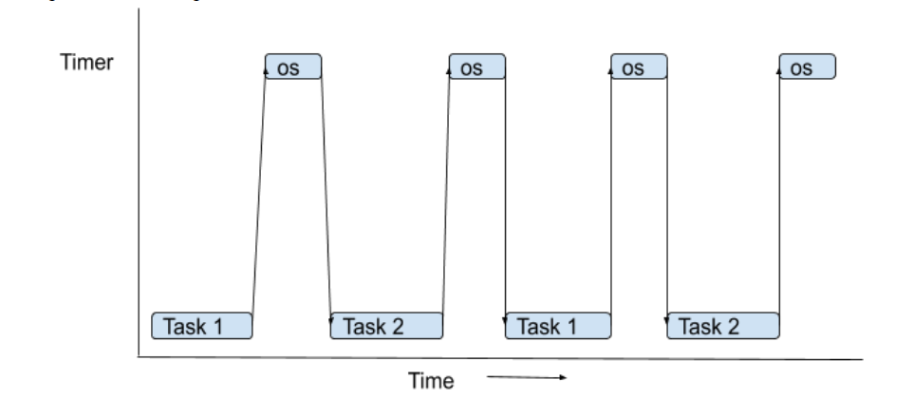
Tick verse Tickless
Tick RTOS uses a time tick to determine which task to run.
Even if you sleep you have to wake up each tick to see if something needs done.
Tickless has each task tell it when it needs to run next.
If no task needs to run then processor can sleep until next task is ready.

Slide 21
RTOS verse Bare Metal
Bare Metal programming can do everything an RTOS does.
Usually with faster execution and with less resources.
RTOS makes code creation faster
Abstracts many details
Allows you to write portable (reusable code)
Allows faster application development
An RTOS does not
Fix bad programming – it amplifies it.
Solve the worlds problems – it just moves the ball down the field

Slide 22
Conclusion
If you have tight development schedule
If you are not resource constrained
Then an RTOS might be for you
Peripheral drivers are often the hard part

